Slide 1
An Analytical Placement Algorithm with Routing topology Optimization
Min Wei, Xingyu Tong, Zhijie Cai, Peng Zou, Zhifeng Lin and Jianli Chen
State Key Lab of ASIC & System, Fudan University, Shanghai 200433, China
Center for Discrete Mathematics and Theoretical Computer Science, Fuzhou University, Fuzhou 350108, China
Presenter : Min-Feng Hsieh
Advisor : Ting-Chi Wang
Notes:
上海鐳達晶元智慧科技有限公司
復旦大學專用積體電路與系統國家重點實驗室

Slide 2
Outline
Introduction
Preliminaries
Proposed Algorithm

Slide 3
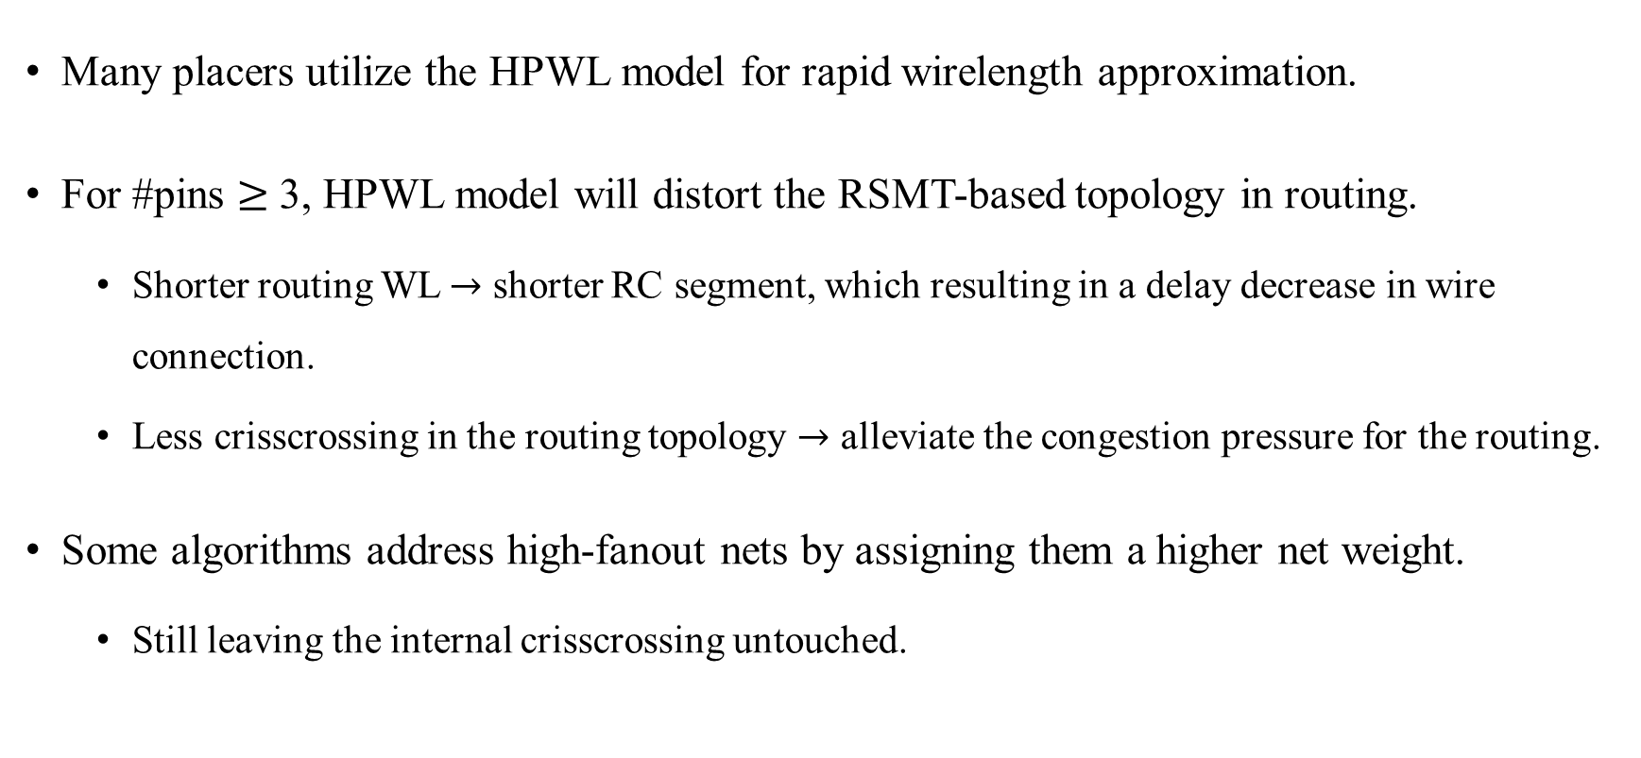
Introduction
Many placers utilize the HPWL model for rapid wirelength approximation.
For #pins $≥$ 3, HPWL model will distort the RSMT-based topology in routing.
Shorter routing WL $→$ shorter RC segment, which resulting in a delay decrease in wire connection.
Less crisscrossing in the routing topology $→$ alleviate the congestion pressure for the routing.
Some algorithms address high-fanout nets by assigning them a higher net weight.
Still leaving the internal crisscrossing untouched.

Slide 4
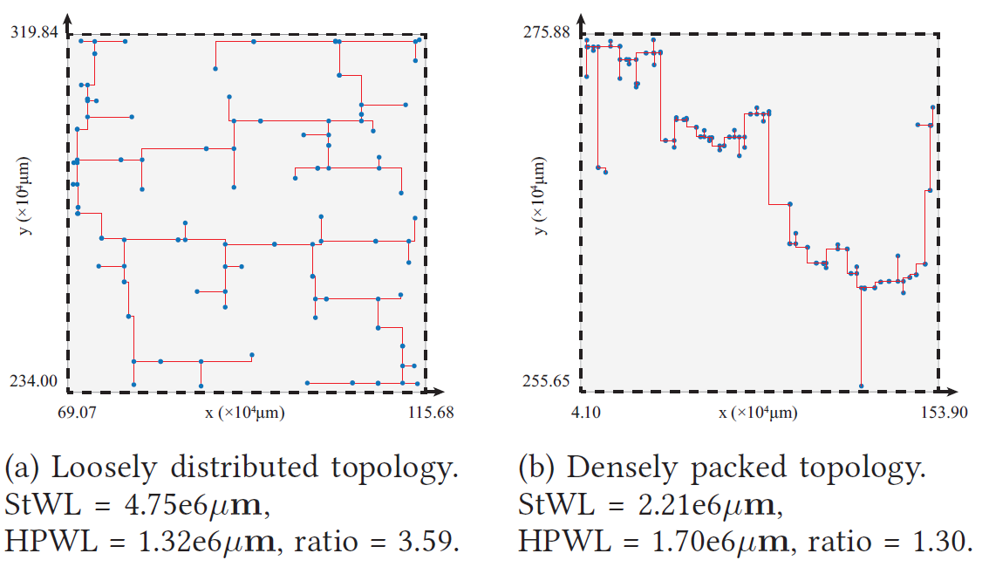
Introduction
The rectilinear Steiner minimal tree (RSMT) is an optimal topology that can accurately approximate the routing wirelength.
StWL: RSMT wirelength
Notes:
圖a的inner point (藍色點)比較稀疏 -> HPWL低，但是StWL高 (因為她的steiner tree遍布整個bounding box)
圖b的inner point (藍色點)比較密集 -> HPWL高，但是StWL低

Slide 5
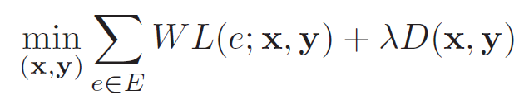
Preliminaries - WL-Driven Analytical Placement
The placers construct a minimization problem of the total wirelength under the cell density constraints.
Objective function:

Slide 6
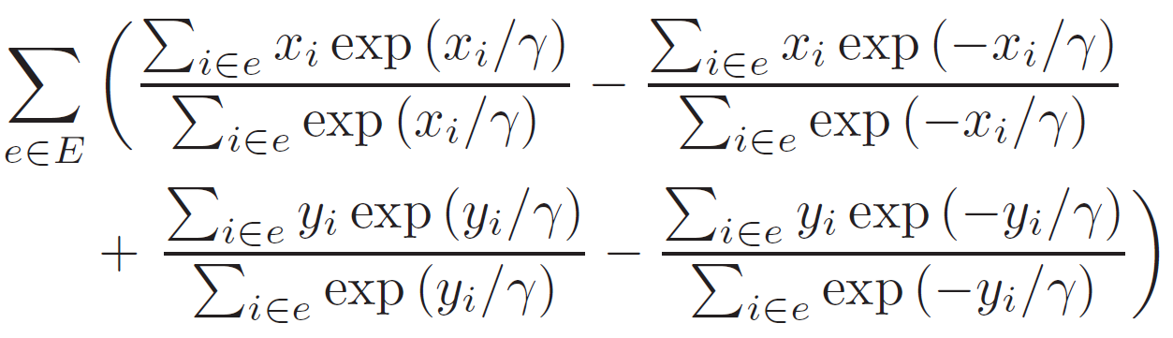
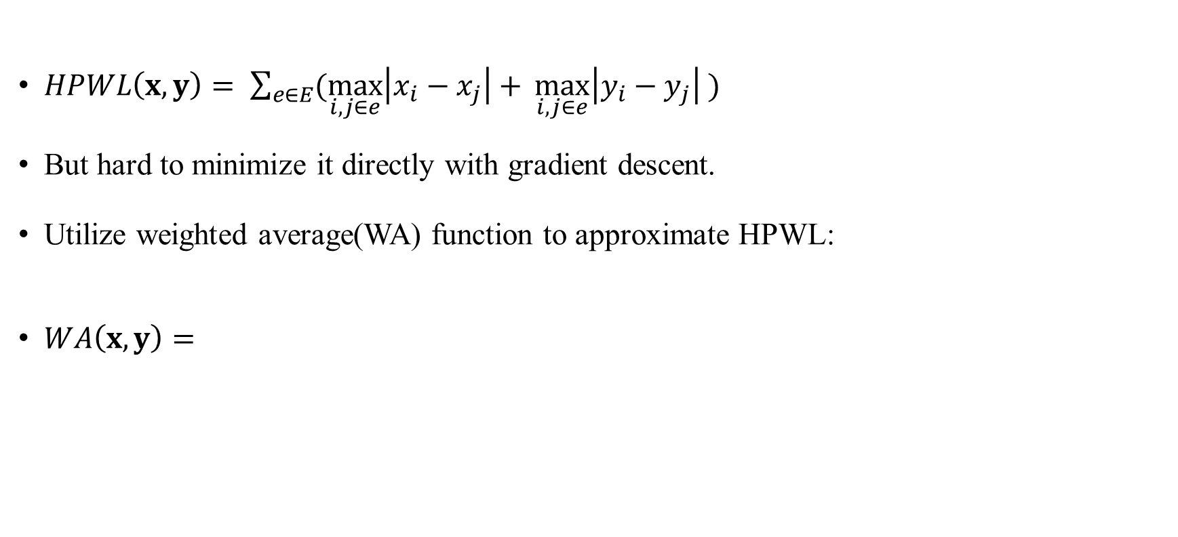


Preliminaries - HPWL Wirelength Model
$HPWL\left(x,y\right)= \sum_{e∈E}{(\max_{i,j∈e}\left|x_{i}−x_{j}\right|+ \max_{i,j∈e}\left|y_{i}−y_{j}\right| )}$
But hard to minimize it directly with gradient descent.
Utilize weighted average(WA) function to approximate HPWL:
$WA\left(x,y\right)=$
$$↑$$
$$γ=maxterm in x\left(y\right)direction$$
$$↑$$
$$γ=minterm in x\left(y\right)direction$$
Notes:
i, j are different pins of the specific net e

Slide 7
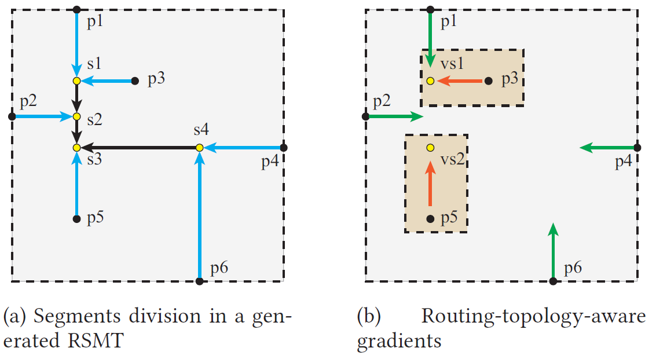
Preliminaries - Analysis of HPWL & RSMT Topology
HPWL model ignores the distribution of interior points, thus losing track of the practical gradient guidance.
Trunks:
Directly connected to the input and
output pins (Physical pins).
Branches:
The remaining part composed
of Steiner points.
trunk
branch
Notes:
(b)圖中的綠色箭頭是HPWL Model的wirelength gradient (只有p1,p2,p4,p6有，其他的interior point 沒有)

Slide 8
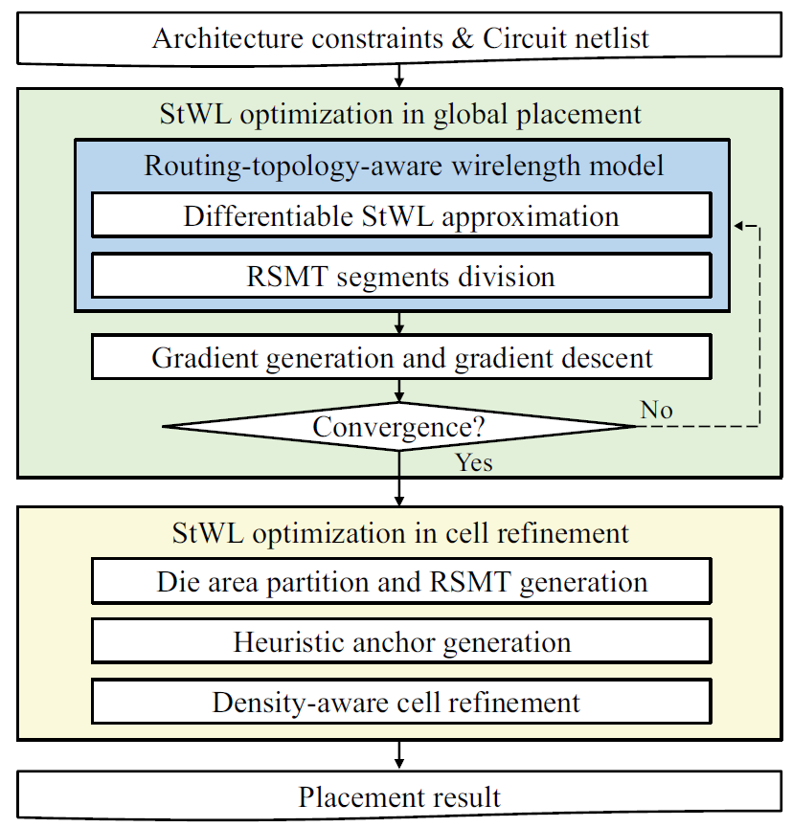
Proposed Algorithm
StWL Optimization in Global Placement.
StWL Optimization in Cell Refinement.

Slide 9
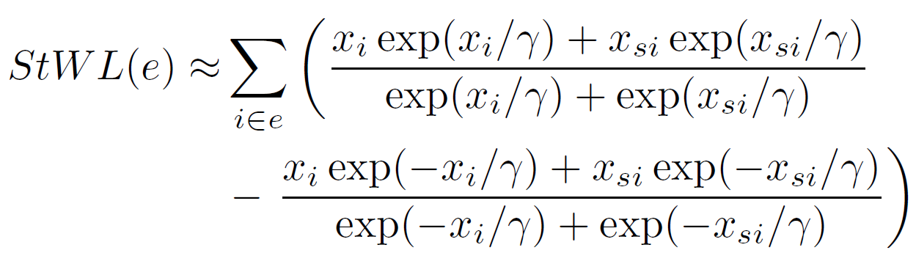

Proposed Algorithm - StWL Optimization in GP
Differentiable StWL Approximation
$StWL\left(e\right)= \sum_{i∈E}{|x_{i} − x_{si}|}$
Each segment can be analyzed separately and seen as a 2-pin net.
weighted average approximation of horizontal StWL for net e:
i : inner point of net e (include steiner points).
si : the parent node of point i.

Slide 10
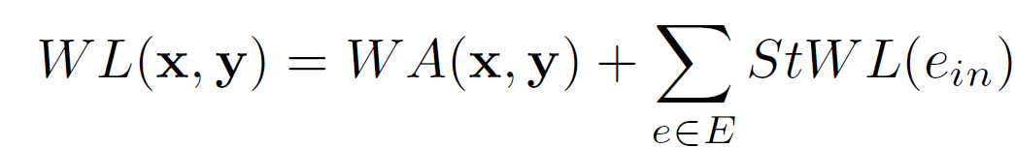

Proposed Algorithm - StWL Optimization in GP
(2) RSMT segments division
It is time-consuming and unnecessary to optimize all parts by a single StWL model.
Assumption: The Steiner points in the topology can be considered fixed in each iteration.
Splits the net into a fixed trunk part and a changeable branch part.
Typically, this assumption is satisfied for most iterations in the GP stage.
Hybrid wirelength model:
trunk
$$e_{in}:interal part of net e$$
branch
Notes:
就是把net分成trunk跟branch
利用Hybrid wirelength model，將WA model可以處理的先處理好(因為速度比較快)，接著那些inner part再用StWL來處理，得到完整的gradient來得到更精準的wirelength.

Slide 11
Proposed Algorithm - StWL Optimization in GP
(2) RSMT segments division
The green arrow is the gradient from the WA wirelength model
Computational efficiency.
Gradient values and directions are pretty close to those provided by StWL model.
To avoids a large number of routing topology analyses.
The arrows between p3 and vs1, p5 and vs2 in the brown
box are the inner gradient for this 6-pin net.
trunk
branch

Slide 12
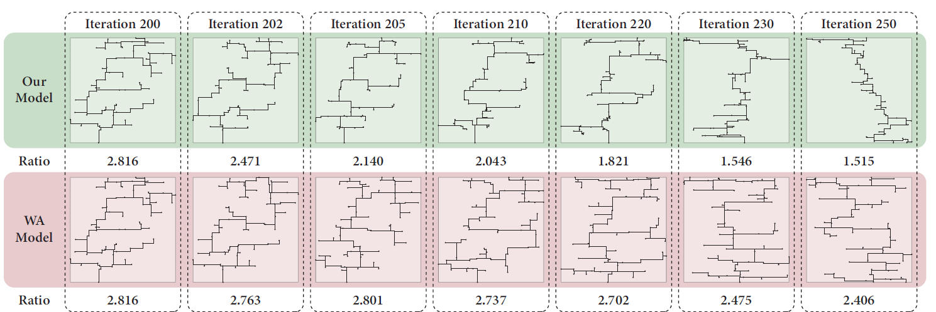

Proposed Algorithm - StWL Optimization in GP
(3) Gradient descent of our wirelength model
For the interior pins, the hybrid Wirelength model can provide gradients to minimize the length of its corresponding segments.
For the pin on the net bound, their shrinking gradient is provided by the $WA(x, y)$term.
Notes:
相較於WA Model的net依舊十分混亂，他們的Model會將trunk附近的cell聚集，使的net的內部部分的結構更加整潔

Slide 13
Proposed Algorithm - StWL Optimization in Cell Refinement
Analytical placement is “convergence” when cells are scattering with tolerable density violations.
If convergence, further iterations only perform trivial cell displacement.
Aside from gradient descent, there is still room for RSMT refinement with routing-topology-aware wirelength model.
They propose a placement violation refinement algorithm with a heuristic RSMT optimization strategy.
Moving cells to their wirelength-optimal region hastily would obviously deteriorate the low overlap distribution given by analytical global placement.
They posed bin-level density control in cell movement to keep the incremental refinement swift and plausible.
Notes:
會破壞GP所做出來的solution

Slide 14
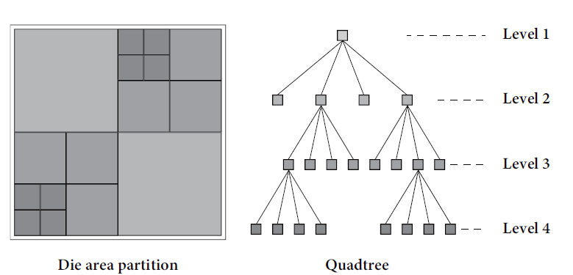
Proposed Algorithm - StWL Optimization in Cell Refinement
Framework of the refinement algorithm
Utilize branch and bound method for swift density check.
The whole die is divided into four identical coarse bins.
Use a quadtree to store the available area of the four bins in each node.
Each child node regions will continue to be divided until the finest bin granularity (5-10 times the row height).
The cells in the same bin are considered to share the same coordinates at each granularity.
Notes:
在每一個level中，在同一個bin(也就是樹的node)的cell都會被看成共享同一個coordinate.

Slide 15
Thank you for listening!

